Slide 1

Cognitive Test Scores of Preschoolers Prediction
Presented by Yifei Zhu
Notes:
Ok thank you and let me go ahead and present my project. This is a study to predict the cognitive test scores of preschoolers.

Slide 2

What is Cognitive Test?
Cognitive testing checks for problems with cognition. Cognition is a combination of processes in the brain that's involved in almost every aspect of life. It includes thinking, memory, language, judgment, and the ability to learn new things.
Cognitive test is often used to determine a child’s learning capability or learning potential by identifying their cognitive strengths and weakness.
Notes:
So let me introduce what is coginitive test first. Cognitive testing checks for problems with cognition. Cognition is a combination of processes in the brain that's involved in almost every aspect of life. It includes thinking, memory, language, judgment, and the ability to learn new things. Cognitive test also known as IQ test, is often used to determine a child’s learning capability or learning potential by identifying their cognitive strengths and weakness.

Slide 3
Cognitive Test Example
Montreal Cognitive Assessment (MoCA): This test involves memorizing a short list of words, naming objects shown in pictures, copying shapes and performing other tasks. This test takes about 15 minutes to complete.
Mini-Mental State Exam (MMSE): This test involves counting backward, identifying objects in the room, stating the date and other common, well-known facts. This test takes about 10 minutes.
Mini-Cog: This test involves memorizing and recalling a three-word list of unrelated words and drawing a circle clock — adding all time points, then drawing hands to show a specific time. This test is the shortest (under three minutes) and easiest to complete.
Notes:
Cognitive Test involves a series of different activities. There are three most common tests as shown here.

Slide 4
Introduction
Motivation: IQ(Intelligence quotient) is a key measure of intelligence that is adjusted for age. Therefore, it is important to investigate the factors that affecting IQ development especially at a young age
Main Goal: Analyze and predict cognitive test scores of preschoolers given characteristics of their mothers to examine the relationship between mothers’ characteristics and their child's IQ
Approach: Exploratory Data Analysis, Linear Regression Model and Cross Validation in Python
Notes:
To begin with, I want to introduce the project in the scope of motivation, main goal and the approach. We all know that IQ is the .. So the main goal for this study would be to …. The approach has three parts: …

Slide 5
Data Preparation
Step 1
Read in the txt file and split data by ‘|’ to get three separate columns as Index, Variable, Value
Step 2
Process invalid values and rearrange columns
Step 3
Read head of the data frame and its summary
Step 4
Check for missing values
Step 5
Reformat data frame so it is easy for analysis
Notes:
So before we start it, we first prepare the data which consists of 5 steps

Slide 6
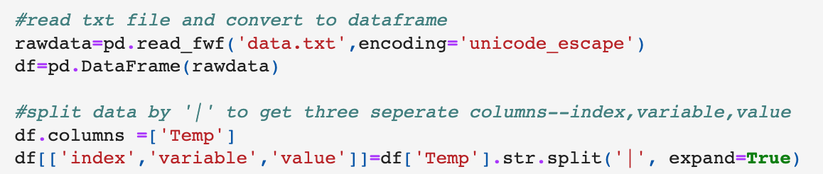
Data Preparation
Step 1
Read in the txt file and split data by ‘|’ to get three separate columns as Index, Variable, Value
Step 2
Process invalid values and rearrange columns
Step 3
Read head of the data frame and its summary
Step 4
Check for missing values
Step 5
Reformat data frame so it is easy for analysis
Notes:
The first step would be to read in the txt file, split the data into three separate columns as Index, Variable and Value

Slide 7
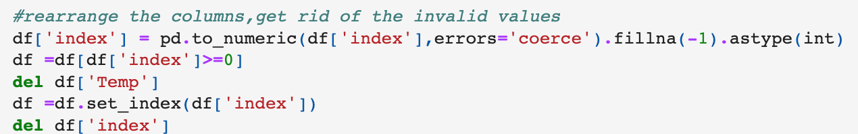
Data Preparation
Step 1
Read in the txt file and split data by ‘|’ to get three separate columns as Index, Variable, Value
Step 2
Process invalid values and rearrange columns
Step 3
Read head of the data frame and its summary
Step 4
Check for missing values
Step 5
Reformat data frame so it is easy for analysis
Notes:
The second step is to process invalid values and rearrange columns. There is special characters in the file so I used the to_numeric function to detect and fill any unreadable item as -1, then filter out all the negative inputs to get rid of the abnormal characters. I also used set index method to set the index using my existing index columns.

Slide 8
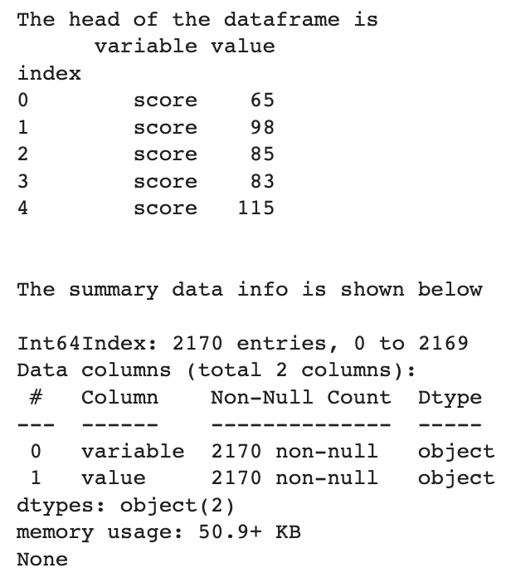
Data Preparation
Step 1
Read in the txt file and split data by ‘|’ to get three separate columns as Index, Variable, Value
Step 2
Process invalid values and rearrange columns
Step 3
Read head of the data frame and its summary
Step 4
Check for missing values
Step 5
Reformat data frame so it is easy for analysis
Notes:
Now we read the head of the data frame and its summary table as presented here

Slide 9
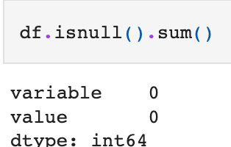
Data Preparation
Step 1
Read in the txt file and split data by ‘|’ to get three separate columns as Index, Variable, Value
Step 2
Process invalid values and rearrange columns
Step 3
Read head of the data frame and its summary
Step 4
Check for missing values
Step 5
Reformat data frame so it is easy for analysis
Notes:
Then I check for missing values. In this case, we don’t have any missing values.

Slide 10
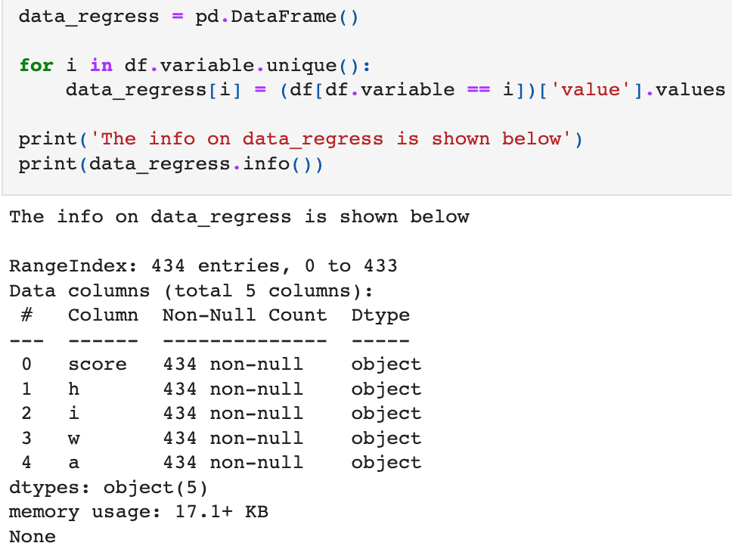
Data Preparation
Step 1
Read in the txt file and split data by ‘|’ to get three separate columns as Index, Variable, Value
Step 2
Process invalid values and rearrange columns
Step 3
Read head of the data frame and its summary
Step 4
Check for missing values
Step 5
Reformat data frame so it is easy for analysis
Notes:
Finally, I want to reformat the data frame for analytical needs. So for each unique variable, I assign it with its associated values and store in a new data frame called data_regress. So the resulting data frame have five columns: Score, h, i, w, and a.

Slide 11
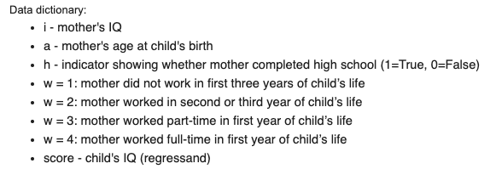
Data Preparation
Step 1
Read in the txt file and split data by ‘|’ to get three separate columns as Index, Variable, Value
Step 2
Process invalid values and rearrange columns
Step 3
Read head of the data frame and its summary
Step 4
Check for missing values
Step 5
Reformat data frame so it is easy for analysis
Notes:
These columns represent different meanings. I have also attached the data dictionary here for reference: i stands for mother’s iq, a is mother;s age at child’s birth. H is a bineary indicator, if h=1 meaning mother completed high school and h=0 means she did not. W is a categorical data which have four conditions and are mutually exclusive, 1 if mother did not work in first three years of child’s life, 2 if mother worked in second or third year, 3 if mother worked part time in first year and 4 if mother work full time in first year. Score is our depend variable which stands for child’s iq.

Slide 12
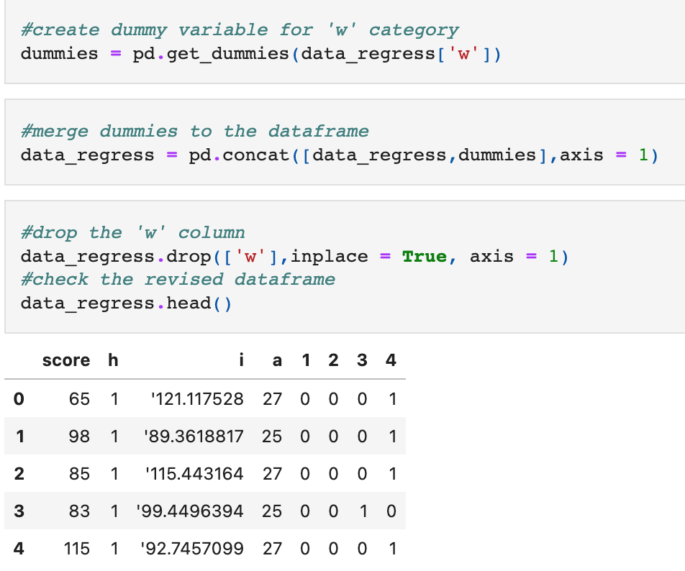
Data Transformation One-hot encoding
For categorical data ‘w’, one–hot encoding should be performed that is to introduce dummy variables representing four different categories
Notes:
Then we move on to data transformation. Notice that ‘w’ is a categorical data, so I implement one-hot encoding here to introduce dummy variables to represent four different categories then drop the ‘w’ column as we don’t need it anymore. Now the data frame look like this.

Slide 13
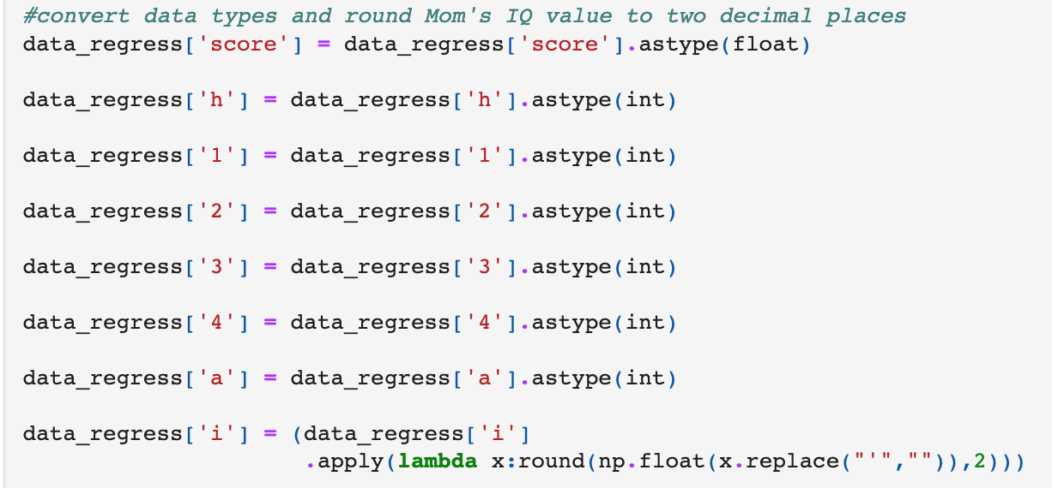
Data Transformation Transform data types
We should convert data types for all five variables from ‘string’ to ‘numeric’ for analytical needs. ‘Score’ and ‘i’ stand for IQ scores thus should convert to floating points numbers and the remaining variables can be used by integer types
Notes:
Notice that the initial data types for all variables are String, we need to convert into numeric for analytical needs. ’Score’ and ’i’ stand for IQ scores, so i use the floating points numbers. The remaining variables like age, education can be expressed by integer. Additionality, I used a lambda expression to process the values in i columns and round it to two decimal places.

Slide 14
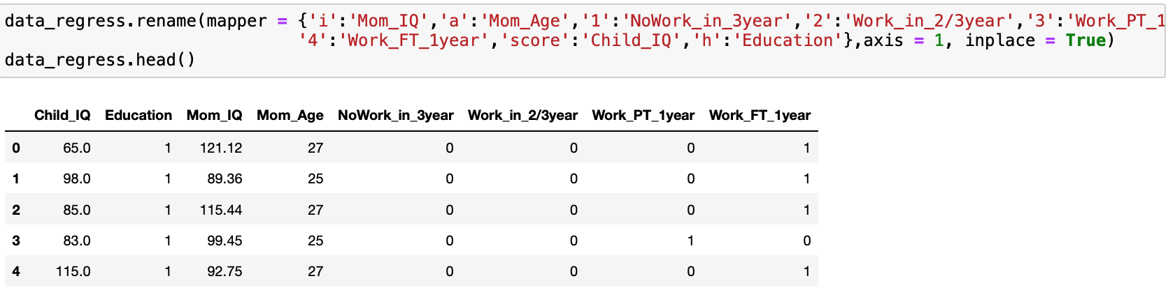
Data Transformation Rename columns
We then work on rename the columns, substitute into words for easier understanding
Notes:
After converting the data types, we then move on to rename these columns, substitute them into words for easier understanding. Check the head of the revised data frame as shown here.

Slide 15
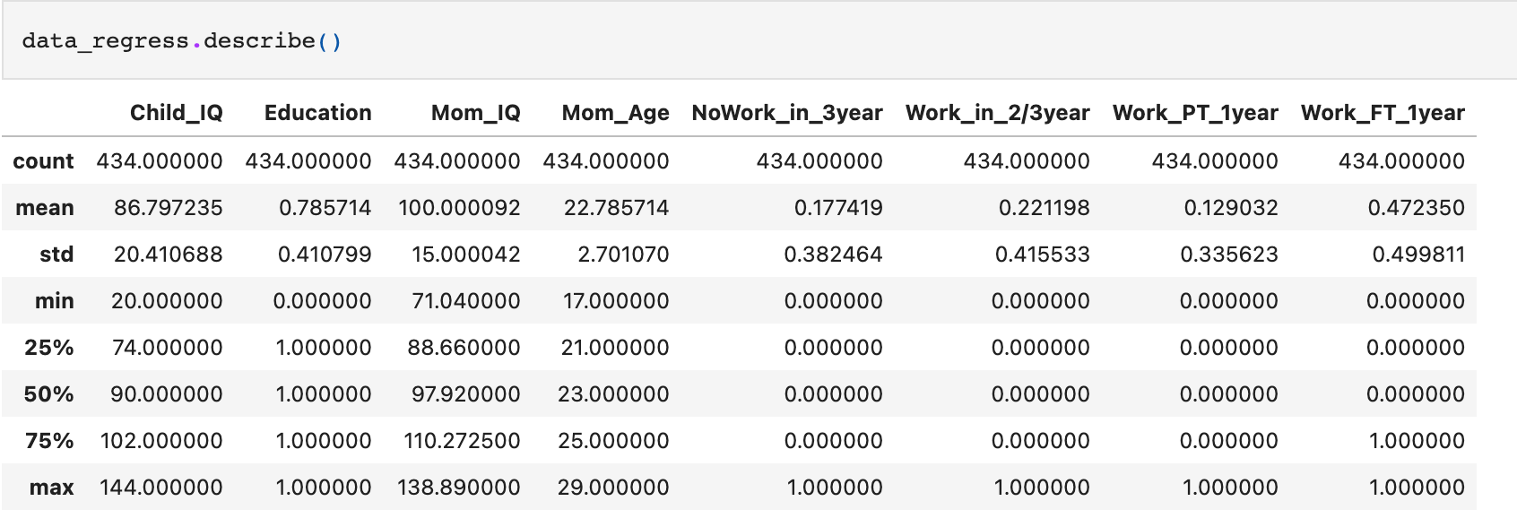
Exploratory Data Analysis First check the statistical measures of all variables
Notes:
Since we have the data ready, we first perform the exploratory data analysis by looking at the statistical measures of all variables. The mean for child iq is 86.8 with minmuin 20 and maxmiums 144. the mean for mom iq is 100 with 71 as minimum and 138.89 as maximum. and the mean of their age is around 23 the oldest being 29 and the youngest being 17.

Slide 16
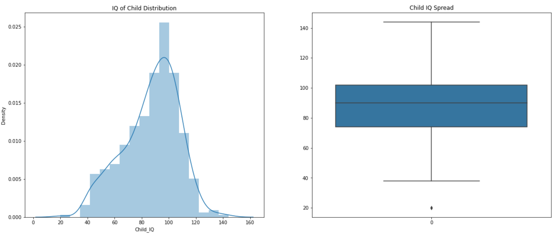
Exploratory Data Analysis Child IQ Visualization
Notes:
Then we move on to visualization. From the graph above, the child IQ distribution is left-skewed. It occurs when there is a higher boundary in the data set. About 75% of Child IQ is greater than 75.

Slide 17
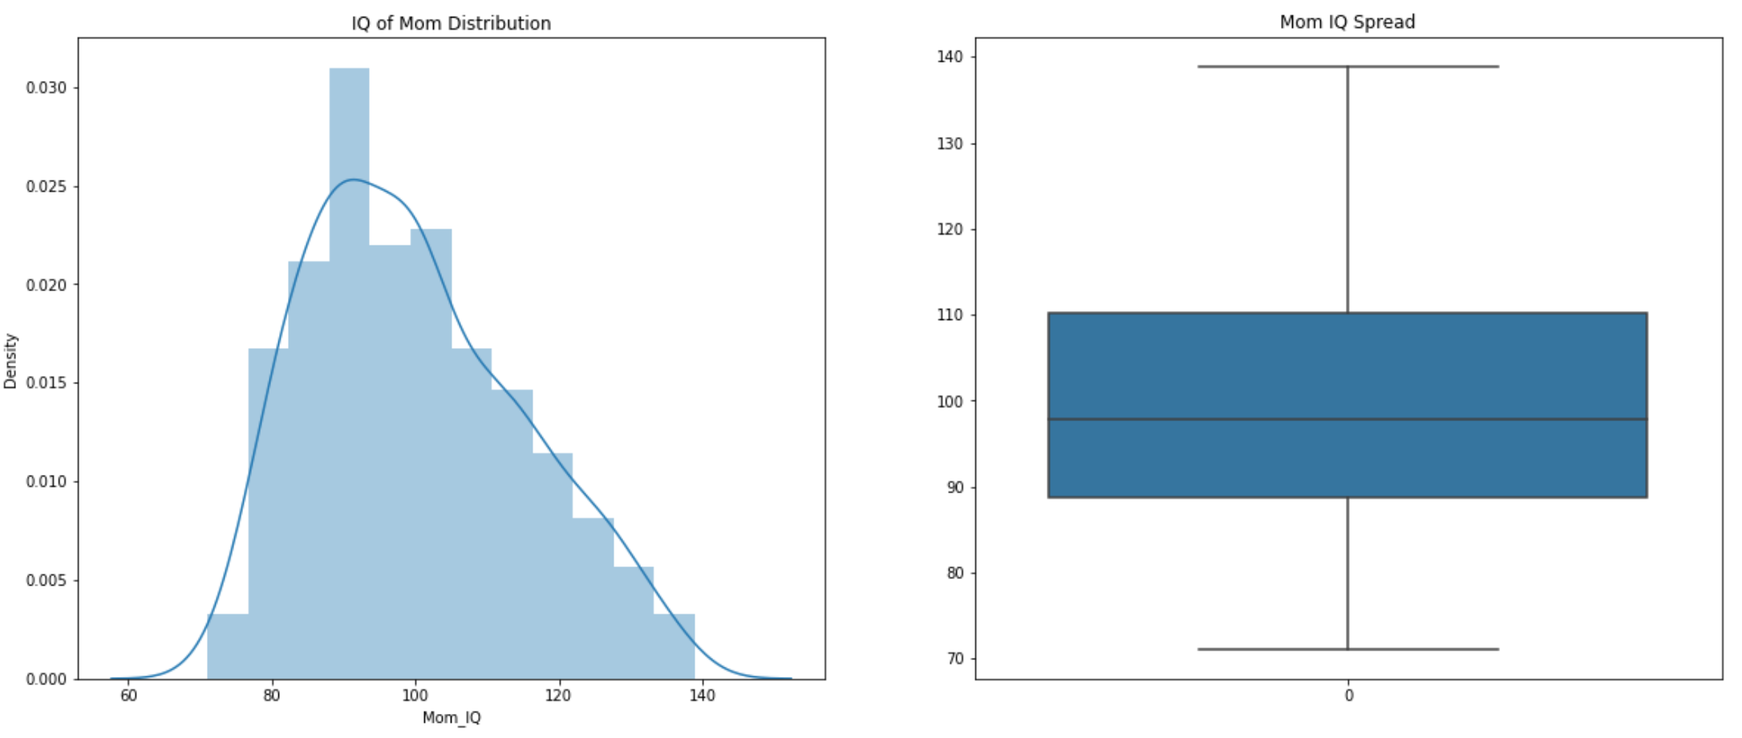
Exploratory Data Analysis Mom IQ Visualization
Notes:
the mom's IQ distribution is right-skewed. That means the outliers of the distribution curve are further out towards the right. Around 75% of mom's IQ is greater than 90 with range from 71 to 139

Slide 18
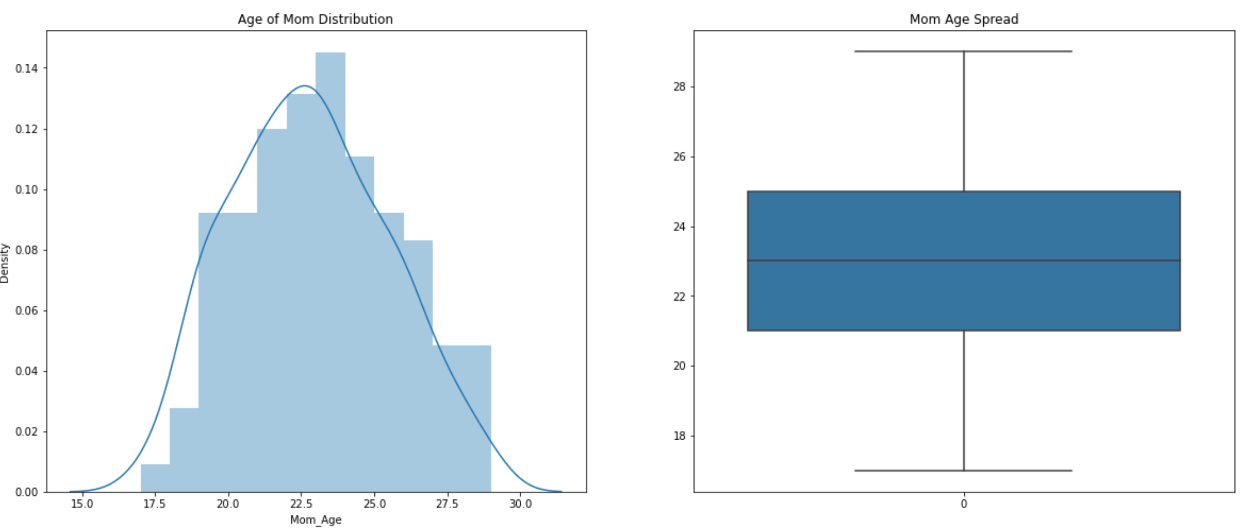
Exploratory Data Analysis Mom Age Visualization
Notes:
From the graph, the mon's age seems to be normally distrubuted. Around 75% of Mom age is greater than 21. The range is from 17 to 29

Slide 19
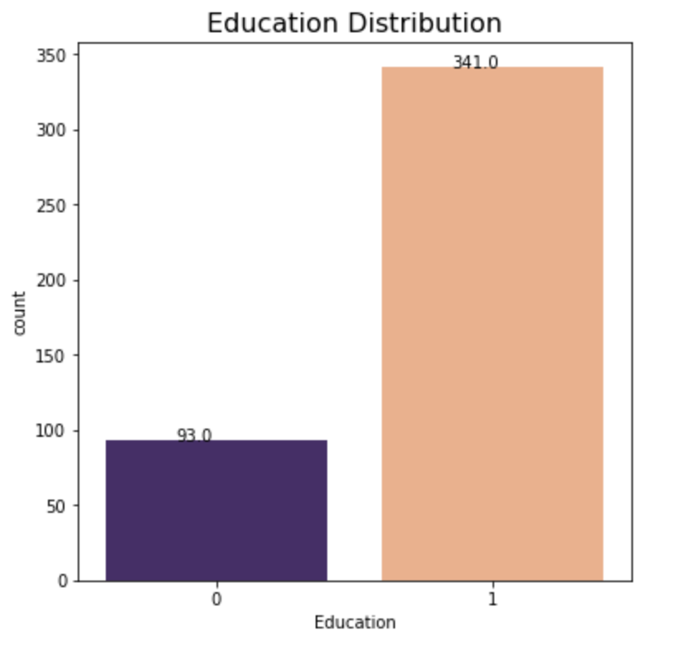
Exploratory Data Analysis Education Visualization
Notes:
According to the count plot, there are 341 mom completed high school and only 93 mothers did not complete.

Slide 20
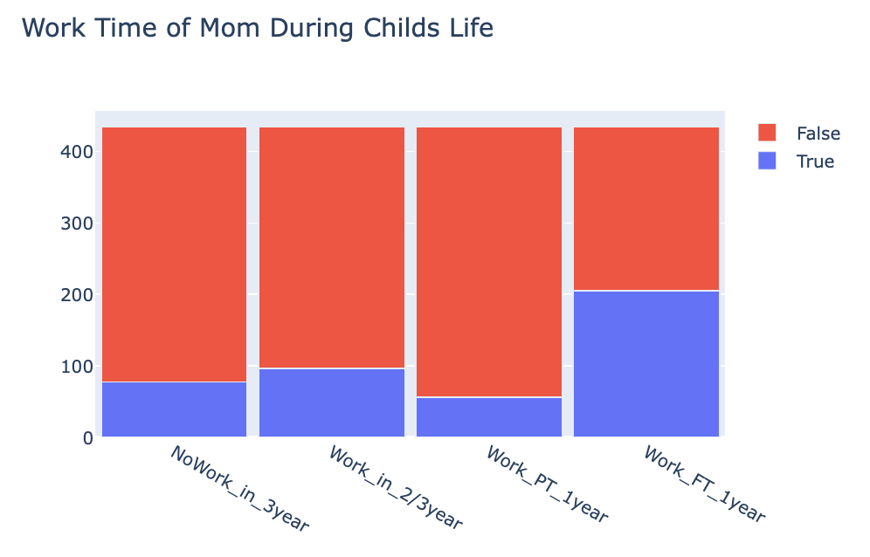
Exploratory Data Analysis Work Time Visualization
Notes:
From the histogram, we can tell that the majority of mothers worked full-time in first year child's life. Those who worked part-time in first year is the least proportion among these four.

Slide 21
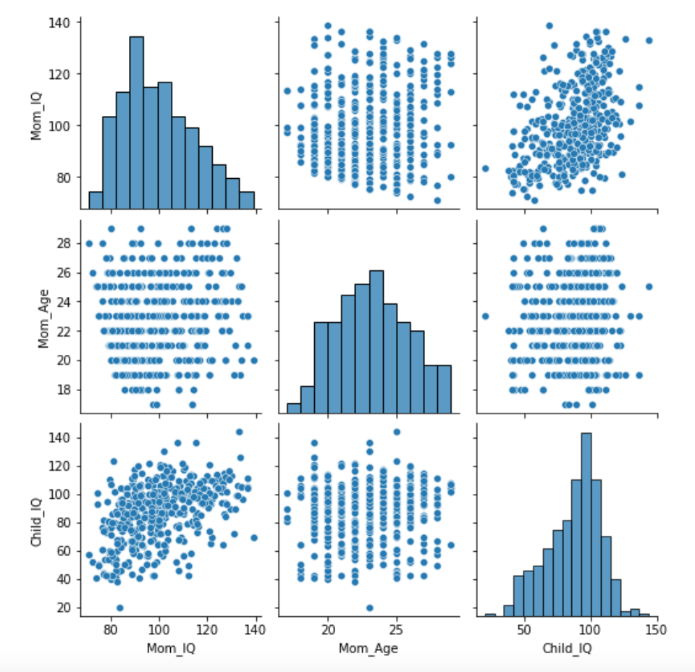
Exploratory Data Analysis
Pair plot that reflects the pairwise relationship among numerical variables(Mom IQ, Child IQ, Mom Age)
Notes:
Pair plot is a powerful tool to reflect the pairwise relationship among numerical variables. Based off the pairplot, Mom_IQ seems to be the most correlated feature with Child_IQ. Let's proceed to plot a jointplot to see if the linear relationship between Mom's IQ and Child's IQ makes sense.

Slide 22
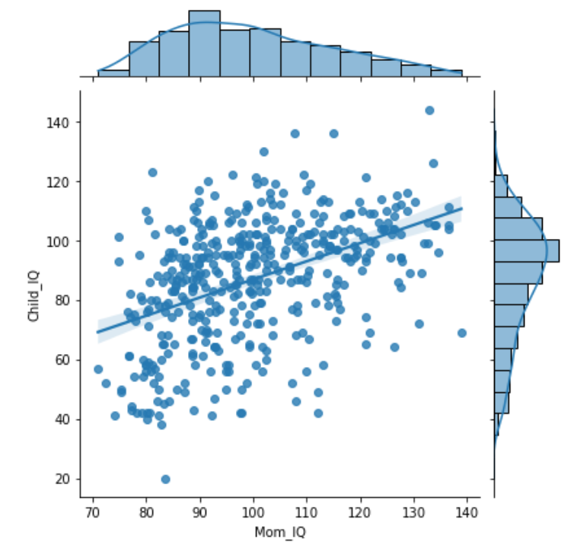
Exploratory Data Analysis
Create a joint plot to see if the linear relationship between Mom IQ and Child IQ makes sense
Notes:
After fitting a regression line to the joint plot, even these relatively noisy data have a significant trend. As Mom_IQ increases, the Child_IQ also increase. But the spread of the data points around the predicted mean at any given location along the regression line are expected to be large.

Slide 23
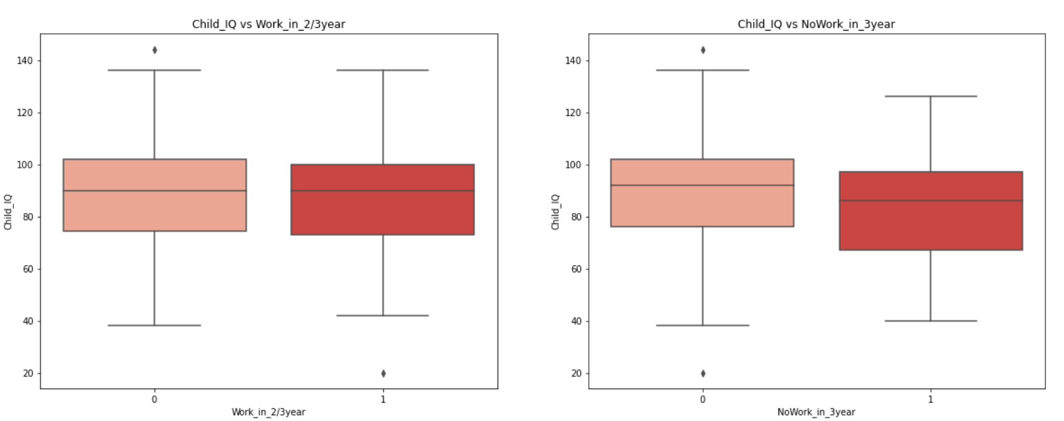
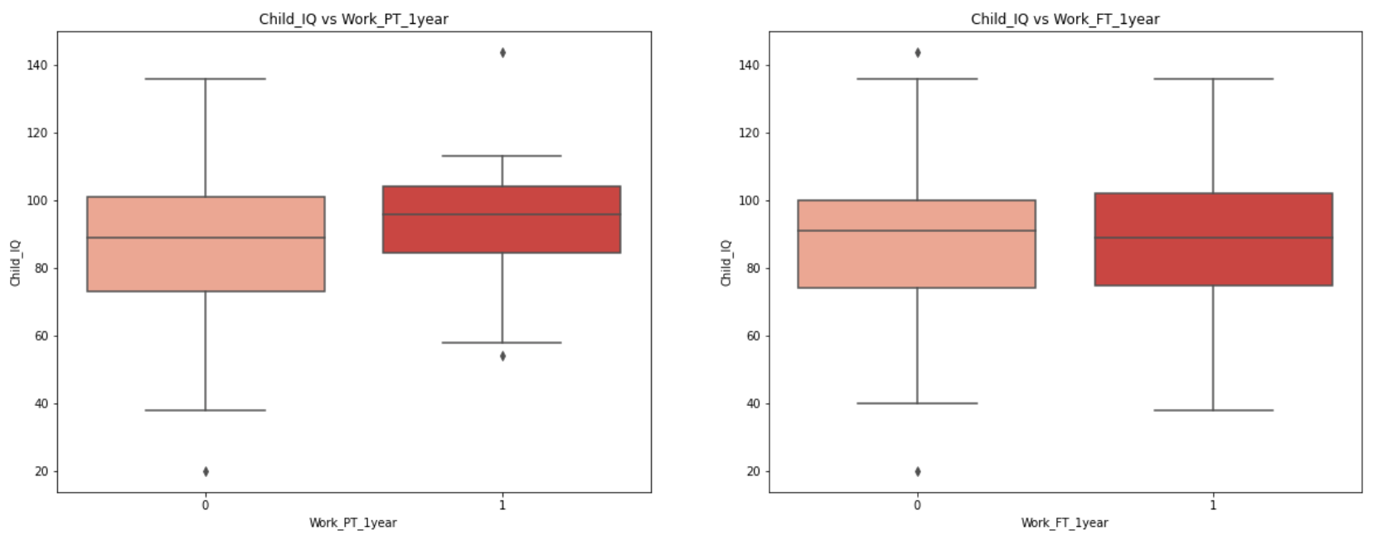
Exploratory Data Analysis
Create box plot to visualize categorical data
Notes:
Now we move on to visualize categorical data. From the box plots, we can see that whether or not mom 'Work in second/third year' and 'Work full time in first year' do not show an obvious difference on child IQ. However, mom who do not work in first three years and who work part time in first year, their child IQ have a smaller range. However, This may due to the fact that we have limited sample size for these two categories.

Slide 24
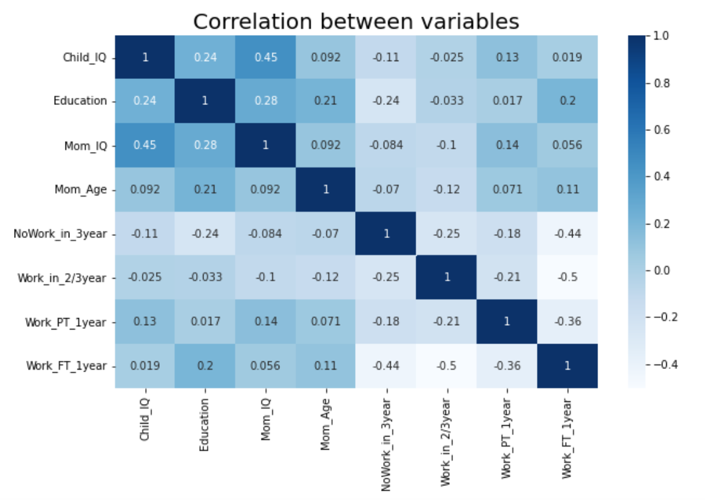
Exploratory Data Analysis
Correlation heat map to visualize correlation between variables
Notes:
Then we create a correlation heatmap to visualize correlation between these variables. From the heatmap, it is obvious that 'Education' and 'Mom IQ' are strongly correlate to 'Child IQ'. 'Mom_IQ','Mom_Age' and 'Work_FT_1year' correlate to 'Education'. However, correlation does not necessarily imply causation. We will continue to build linear regression models to validate it.

Slide 25
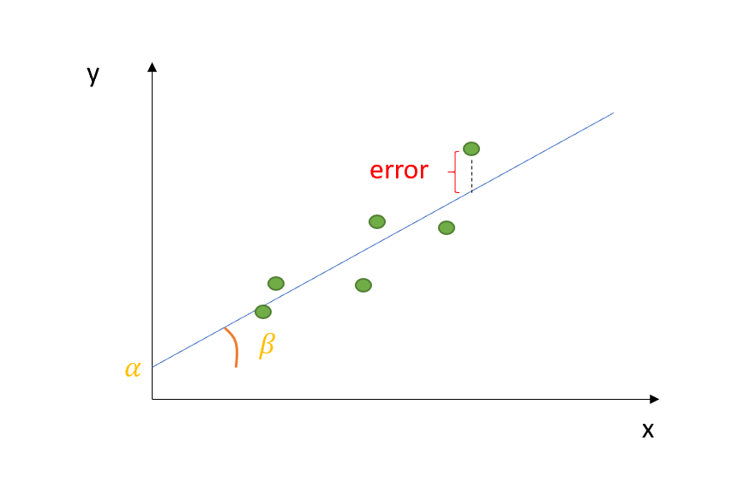
Ordinary Least Square (OLS) Method
OLS is a powerful way to analyze the relationship between one or more independent variables and a dependent variable
This method estimates the relationship by minimizing the sum of the squares in the difference between the observed and predicted values of the dependent variable configured as a straight line
Notes:
The method I used for implementing linear regression model is the Ordinary Least Square method. It is a powerful……. Look at the graph here, we have those green spots as our data, what OLS does is to find the best fit line that minimize the sum of squares in the distance from the green spots to the predicted line labeled as error.

Slide 26
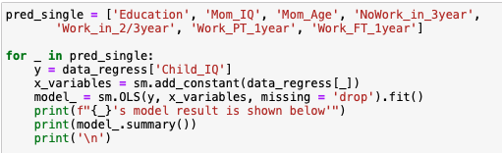
Linear Regression for Single Predictor
Notes:
Okay, let’s move on to create linear regression model for each single predictor. I also wrote a for loop here to automate the process of implementing OLS and generating regression report.

Slide 27
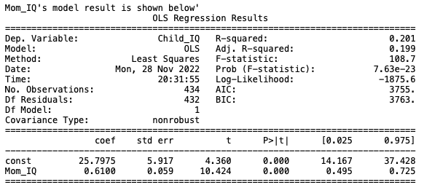
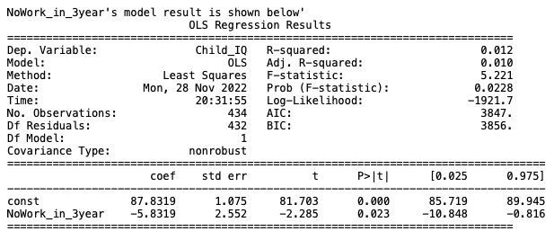
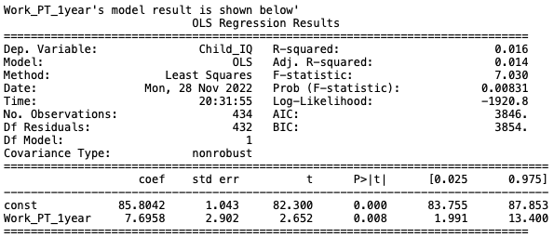
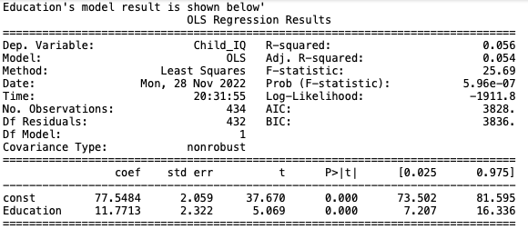
Simple Linear Regression
Among all the regression results, ‘Education’, ‘Mom IQ’, ‘Work PT 1 year’, ‘NoWork in 3 year’ outperform other predictors
Their P-values are significant (less than 0.05) and R-squared are relatively high
Notes:
Now we look at the model‘s statistics, specifically R-squared and P-value as they are the key metrics to evaluate model’s performance. 'Education','Mom_IQ','Work_PT_1year','NoWork_in_3year' outperform other variables. Their P values are significant(which means less than 0.05) and R-squared are relatively high compared to other models this shows a good sign for fitting.

Slide 28
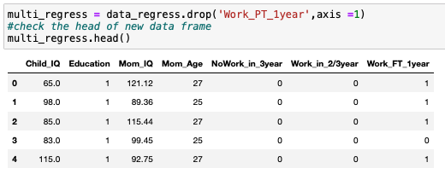
Dummy Variable Trap
Before proceed to multiple linear regression, we need to drop one dummy variable to avoid multicollinearity
Notes:
Before we proceed to multiple linear regression ,we should be cautious about the dummy variable trap. This occurs when two or more dummy variables created by one hot encoding are highly correlated. Therefore, we should drop one dummy variable to avoid multicollinearity.

Slide 29
Backward Stepwise Selection
This variable selection method is to begin with a model that contains all variables then starts removing the least significant variables one after the other
Consider we only have a relatively small groups of predictors, we will perform it manually
Notes:
I use backward stepwise selection as the variable selection method. This method will begin with a model that

Slide 30
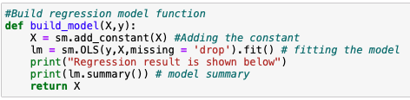
Multiple Linear Regression
Notes:
For future convenience, I wrote a function here to increase the efficiency of dropping variables and implementing to the new model. This function will automatically apply OLS and produce regression result easily.

Slide 31
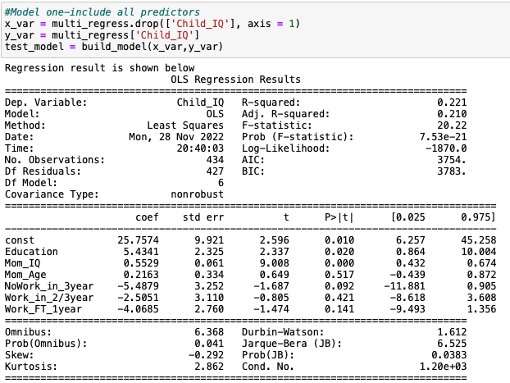
Full Model (including all predictors)
From the full model, we can tell that ‘Mom Age’ has the highest P-value(0.517>0.05) indicating the least significant predictor, so we are going to drop this variable
Notes:
First of all , the model will include all the variables as the full model. From the result, we can tell that…

Slide 32
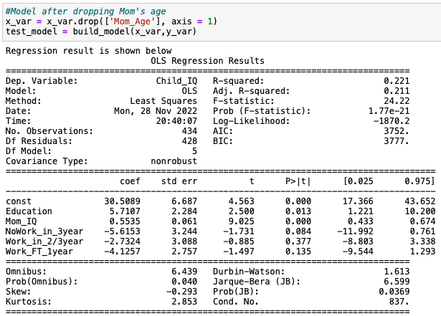
Revised Model (after dropping ‘Mom Age’)
From the full model, we can tell that ‘Work in 2/3 year’ has the highest P-value(0.377>0.05) indicating the least significant predictor, so we are going to drop this variable
Notes:
After drop the mom age variable, we have a revised model. This time, work in the second or third year has ….

Slide 33
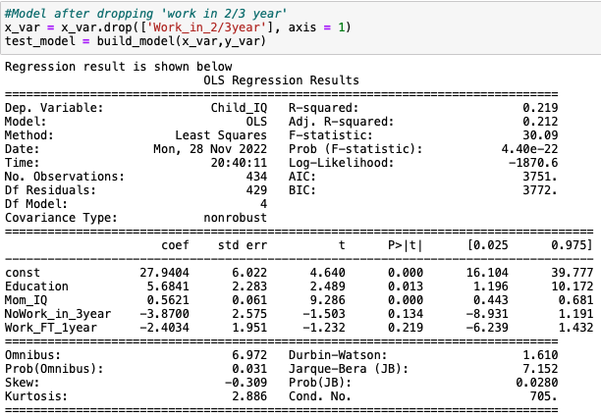
Revised Model (after dropping ‘Work in 2/3 year ’)
From the full model, we can tell that ‘Work FT 1 year’ has the highest P-value(0.219>0.05) indicating the least significant predictor, so we are going to drop this variable
Notes:
After droping the work in second or third year, work full time in first year obtained the highest p value in the revised model. So we are going to drop this and move on.

Slide 34
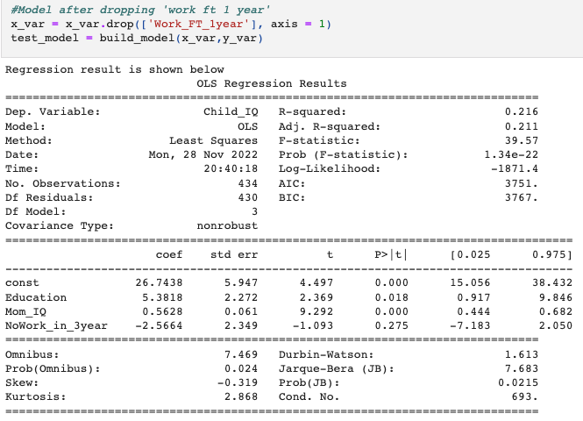
Revised Model (after dropping ‘Work FT 1year ’)
From the full model, we can tell that ‘NoWork in 3 year’ has the highest P-value(0.275>0.05) indicating the least significant predictor, so we are going to drop this variable
Notes:
This time we have ….. Let’s drop it and repeat the procedure

Slide 35
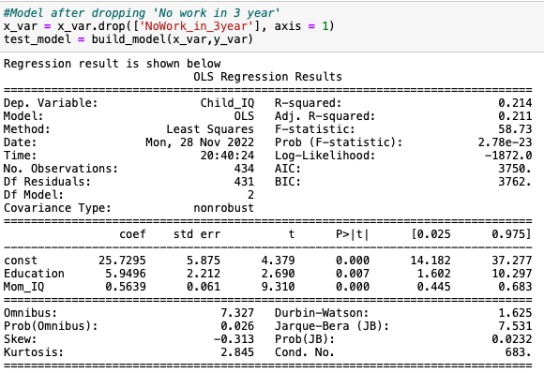
Revised Model (after dropping ‘NoWork in 3year ’)
Now we have all the significant inputs and a relatively high Adjusted R-squared for our model
Notes:
Ok. Now we have all the significant value less than 0.05 and the adjusted r-squared relatively high compared to other models. Notice that, in multiple linear regression model, we look at adjusted R-squared rather than R-squared. Because R-squared tend to increase if there are more predictors in the model. Adjusted R squared is modified version of R-squared that will indicate the model accuracy measures of the linear models. Okay, We will continue to improve our model by introducing an interaction item.

Slide 36
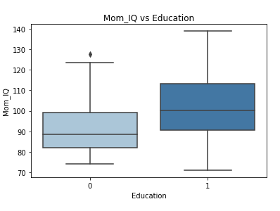
Interaction Term Analysis
Box plot to see the distribution of Mom IQ under different Education Group
Notes:
We first want to decide which interaction term to use. According to our model, it is reasonable to check if the interaction between 'Education' and 'Mom_IQ' actually make sense. According to the boxplot, of those mothers who graduated from high school, their IQ range is much larger and the median is around 100 while the median of those who did not graduate from high school is only 90. It is possible that mom who have higher IQ is more likely to complete high school.

Slide 37
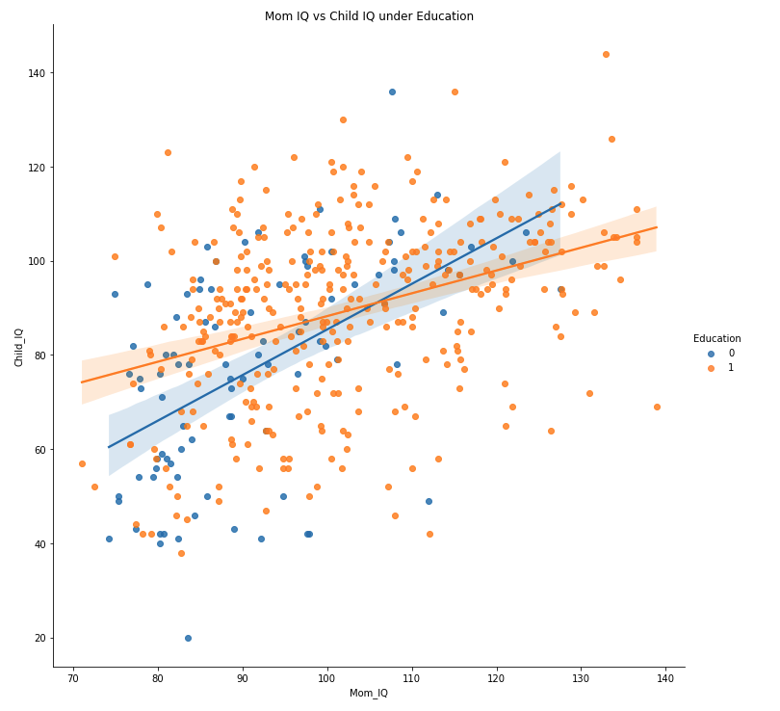
Interaction Term Analysis
Interaction Plot for Mom IQ and Child IQ under different Education group
Notes:
Lets go ahead and create an interaction plot for Mom iq and Child IQ for different education group. I fitted two regression line for case when education=1 and education= 0 respectively. From the interaction plot, the lines are not parallel. This indicates interaction do exists in Mom’s IQ and Education level.

Slide 38
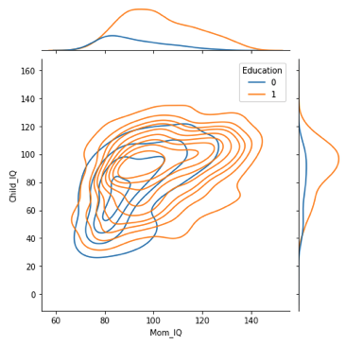
Interaction Term Analysis
KDE plot to visualize how Mom IQ and Education relates to child IQ
Notes:
From the Kde plot, we can have a more comprehensive idea about the probability density difference among Education. Those who did not complete high school, both mom IQ and their child IQ tend to aggregate in the lower center. As you can see from the blue circles . One possible hypothesis would be: of those who did not complete high school, mom IQ tend to be lower which lead to lower child's IQ.

Slide 39
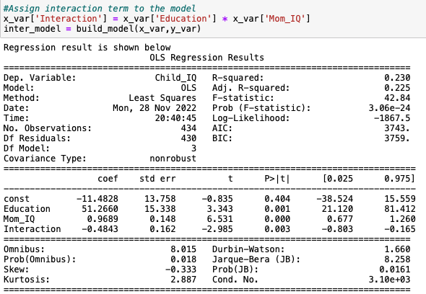
Multiple Linear Regression with Interaction Term
From the result, we can tell that all P-values are less than 0.05 meaning all predictors in this model are significant
Adjusted R-squared increased from 0.211 to 0.225 which indicates model is a better fit with interaction term
Notes:
Based on the analysis, it is reasonable to choose 'Education' and 'Mom_IQ' as interaction term and implement to the multiple linear regression model. From the result, adjusted R-Sqaured increase from 0.211 to 0.225 which indicate that model is a better fit with interaction term. Additionally, all p-values are less than 0.05 meaning the predictors are all significant.

Slide 40
Evaluate Model’s Ability to Predict Future Value
Split the data into training and testing sets
Fit the model to training data
Evaluate by predicting off the test values
Notes:
Let's evaluate our model's ability to predict future cognitive test scores by cross-validation. This process consists of three steps.

Slide 41
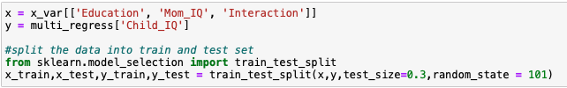
Evaluate Model’s Ability to Predict Future Value
Split the data into training and testing sets
Fit the model to training data
Evaluate by predicting off the test values
Notes:
First, prepare the train and test data by train_test_split

Slide 42
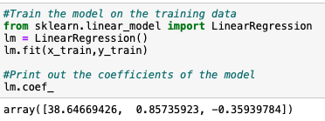
Evaluate Model’s Ability to Predict Future Value
Split the data into training and testing sets
Fit the model to training data
Evaluate by predicting off the test values
Notes:
Then Fit our model to training data and obtained the coefficients

Slide 43
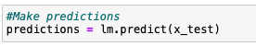
Evaluate Model’s Ability to Predict Future Value
Split the data into training and testing sets
Fit the model to training data
Evaluate by predicting off the test values
Notes:
Now that we have fit our model, let's evaluate its performance by predicting off the test values

Slide 44
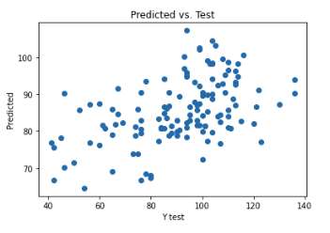
Scatter Plot of Real Test Values vs. Predicted Values
The scatter plots shows Predicted vs. Test Value not to be perfectly linear. This may due to insufficient sample
Notes:
Moving forward, we Create a scatter plot of the real test values versus the predicted values. The scatter plots seems not to be perfectly linear. This may due to our sample size being too small.

Slide 45
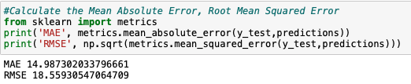
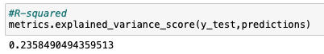
MAE, RMSE, and R²
We want MAE (Mean Absolute Error) and RMSE(Root Mean Squared Error) to be lower meaning the model more likely to predict data accurately. In this case, both MAE and RMSE are not low enough
R-squared measures the proportion of a dependent variable is explained by the independent variables in our model. In this case, it is 23.58% which is not ideal for a good predictive model
Notes:
Let's evaluate our model performance by calculating the residual sum of squares and the explained variance score(R^2)

Slide 46
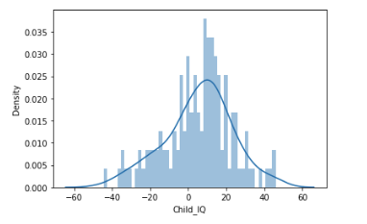
Residuals Analysis
From the plot, the residuals seem to be normally distributed which is a good sign
Notes:
We Continue to analyze the residuals, make sure everything was okay with the data. From the residual plot, …. Because Normality of the residuals is the underlying assumption of running a linear model.

Slide 47
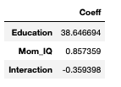
Coefficients Interpretation
on average, a mom who completed high school, her child IQ would be 38.646 higher compared to a child's mother who did not complete high school, assuming other predictor variable remain same
on average, each additional one unit increase of mom IQ score is associated with an increase of 0.857 scores on the child IQ, assuming other predictor variable remain same
For the interaction term, it suggests that as interaction increases, the child IQ tends to decrease
Notes:
From the coefficient output, we can see that the regression coefficient for Education is 38.6. This means that ,on average, a mom who completed high school, her child IQ would be 38.6 higher compared to a child's mother who did not completed high school, assuming other predicor variable remain same. As for the mom IQ, this means that on average, each additional one unit increase of mom IQ score is associated with an increase of 0.857 scores on the child IQ, assumnig other predictor variable remain same. For the interaction term, it suggests that as interaction increases, the child IQ tends to decrease.

Slide 48

Conclusion
Overall, the multiple linear regression model that takes into 'Education’, ’Mom IQ' and interaction term as 'Education'*’Mom IQ' outperform any other regression models. However, this model does not have a good ability to predict new data. This may due to
The sample size being too small
Not sufficient effective predictors

Slide 49

Recommendation
Apart from ‘Education’ and ‘Mom IQ’ , there are other objectives that could make impact on the IQ during child's development like home environment, healthcare condition and learning resources
Suggestion would be to perform:
Demographic segmentation: divide the sample by income/education level
Geographic segmentation: different regions may mean different access to education resources
Child health conditions: other health conditions may affect IQ development
Notes:
Divide the sample by income level since higher income might meaning that mother have more money to spend on their child’s education. As of the education level, if a mother is well-educated, it is more likely for her to invest in her child’s education too. For the geographic segment, different …., for example the education resources in NYC is different from those in the countryside. Meanwhile, the IQ development may also be affected by the child health condition. So we may want to know if the child is suffering from any disease. Overall, I think it is important to constantly improve the model, and ultimately help children to grow up in a surrounding that is beneficial for their iq development.

Slide 50

Reference
Link to the GitHub File: https://github.com/yzhu06/CognitiveTestScorePredict
Cognitive Test: What it is, Different Types & Results
(https://my.clevelandclinic.org/health/articles/22306-cognitive-test) Accessed 12/1/22
Notes:
I have attached all the data source and my code file to the github link as attached here.

Slide 51

Thank you!
Notes:
Thank you and do let me know if you have any questions.

